Slide 1
IT8108 – Mobile Programming
Dr. Philippe Pringuet(coordinator)

Slide 2
Agenda
Learning Outcomes
Technology
Structure
Assessments

Slide 3
Learning Outcomes
Design and implement apps for a mobile platform to a given business requirement
Follow best practice, industry standards, professional ethics, diagram designing, programming and documentation conventions during the programming process

Slide 4
Technology
The course will utilise the Apple iOS mobile platforms
Development environment: Apple Xcode 10.3
Programming language: Apple Swift 5
Infrastructure: AWS Amplify or Google Firebase (not required)

Slide 5
Why iOS development?
https://appinventiv.com/blog/apple-app-store-statistics

Slide 6
Why iOS development?
https://appinventiv.com/blog/apple-app-store-statistics

Slide 7
Why iOS development?
https://medium.com/devslopes-blog/how-much-does-a-freelance-ios-developer-make-6204c3110dc8

Slide 8
Resources and Equipment
All resources are on Moodle
36.201 Mac lab available for self-study (access during or outside of class time)
36A.103 Mac lab available for self-study (access by request to technician)
ONLY MOBILE PROGRAMMING STUDENTS ALLOWED IN MAC LABS
YOU ARE RESPONSIBLE FOR THE EQUIPMENT

Slide 9
Structure/Assessments
A course in 2 halves - Moodle
First part – Tutorials, Design Document
Second part – Project Implementation
Purely project based
Design Document (Phase 1) – Group with individual components, 30%
Implementation (Phase 2) – Group with individual components, 35%
Project Defence – Individual, 35%
Demo to client - Group/Individual, 5%
Critical Analysis - Individual, 5%
Code Updates - Individual, 25%

Slide 10
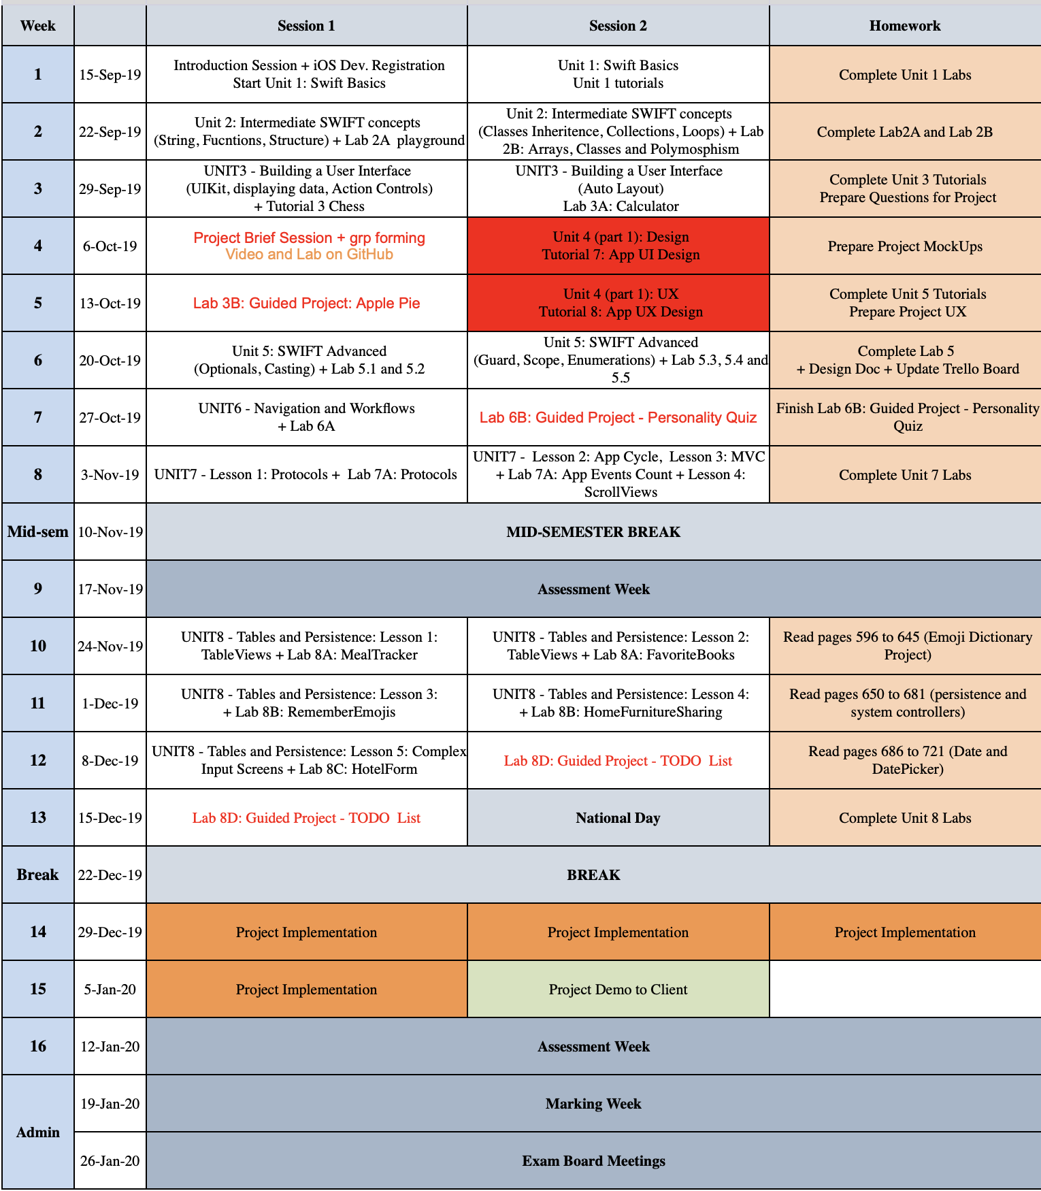
Schedule (for information only)

Slide 11
Policy Reminder
Lateness
Attendance
Plagiarism
Office Hours

Slide 12
Questions?

Slide 13
How to get started?
Go to developer.apple.com
Register using your polytechnic account (email invite sent to your email)
If you want to use your iPhone to test your app, send me the UDID by email
Open xCode, go to preferences
Go to Trello.com
Register using your polytechnic account (email invite sent to your email)
Create a test board to learn the basics of Trello
Go to RosettaHub.com
Check that your Budget is $100
If not, find an old email from AWS and follow the steps to register
Click AWS console and read about AWS Amplify (if you want to use your own machine, you need to install xCode, AWS-cli, node, npm and configure amplify)

